Slide 1
Predicting Movie Revenue
Team: Brandon van Nice, Kyle Haddock, Tamara Harper, Byron Allen

Slide 2
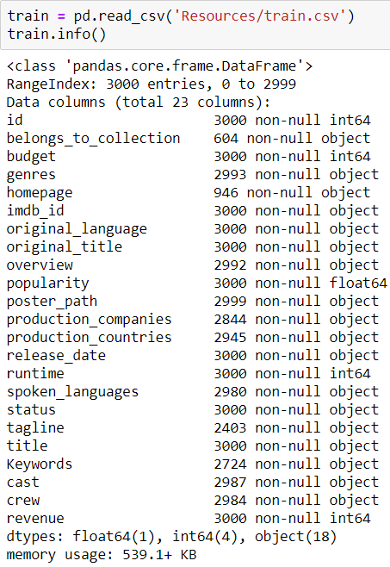
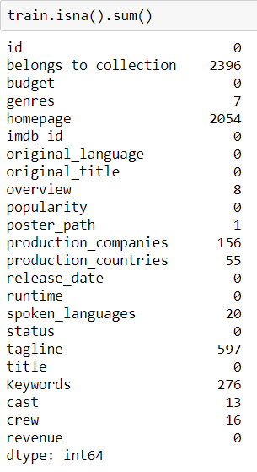
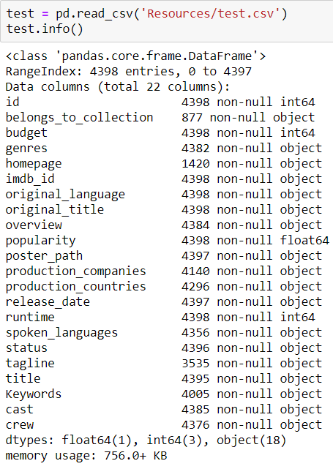
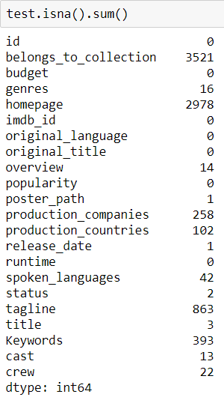
Finding, Cleaning Data
Data available on Kaggle
Original Source: The Movie Database (TMDB)
Removed redundant columns
Genres stored as a list of dictionaries, broken out and dummified

Slide 3
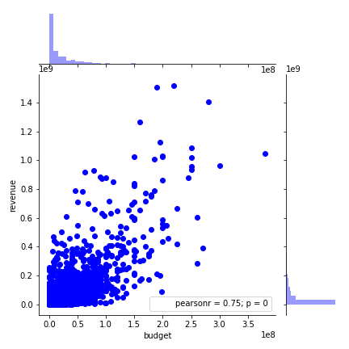
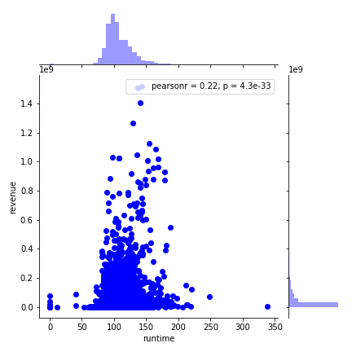
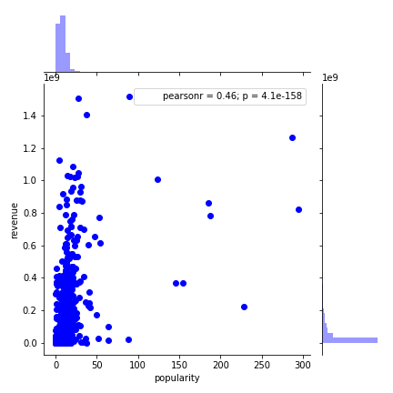
Visualization
Checking the general correlation between certain measures and revenue
Budget
Runtime
Popularity
General trends but quite a few outliers

Slide 4
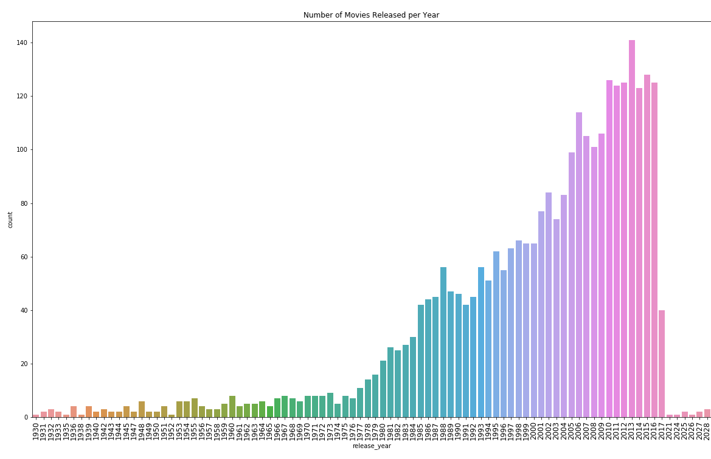
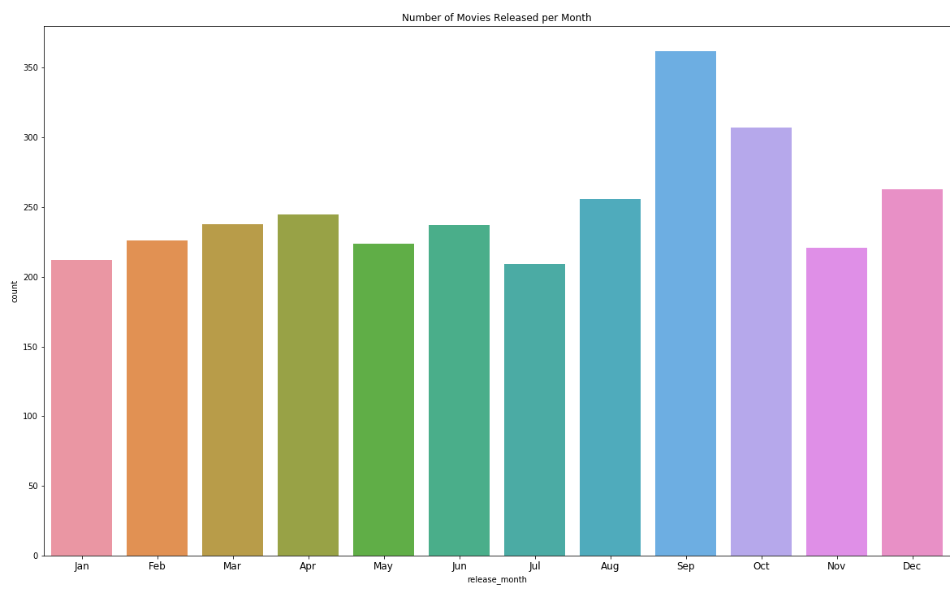
Visualization
Sheer volume per year
Average releases per month

Slide 5
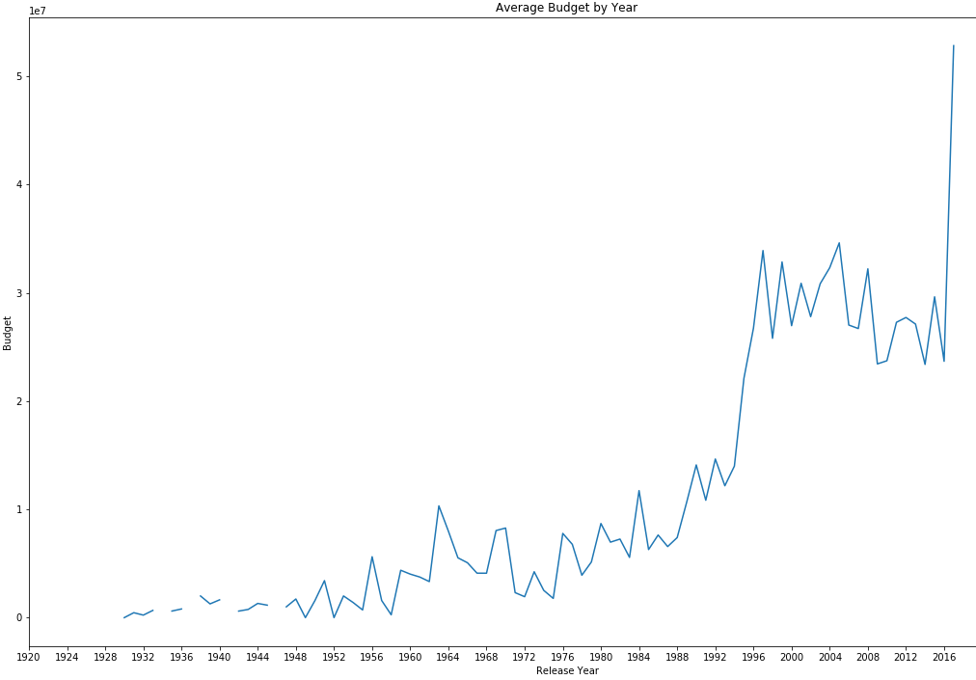
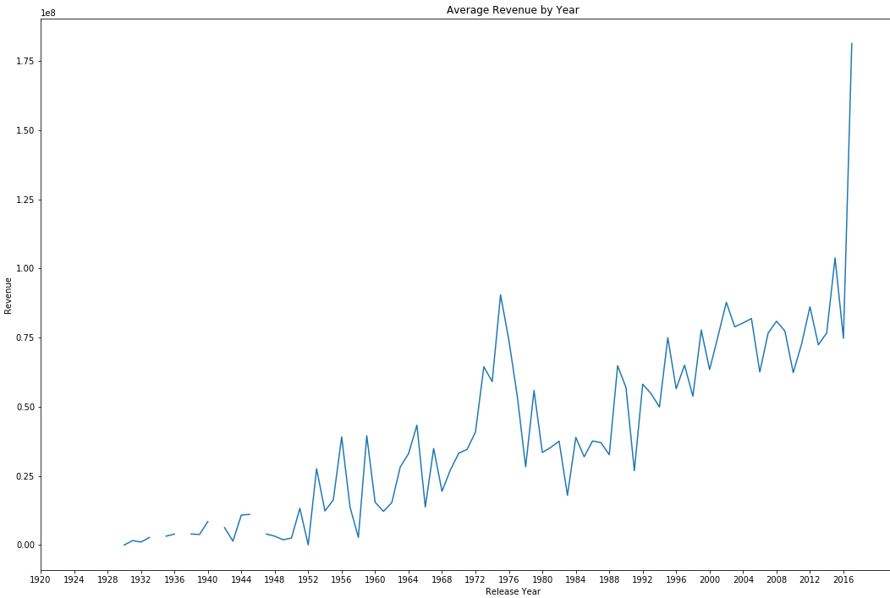
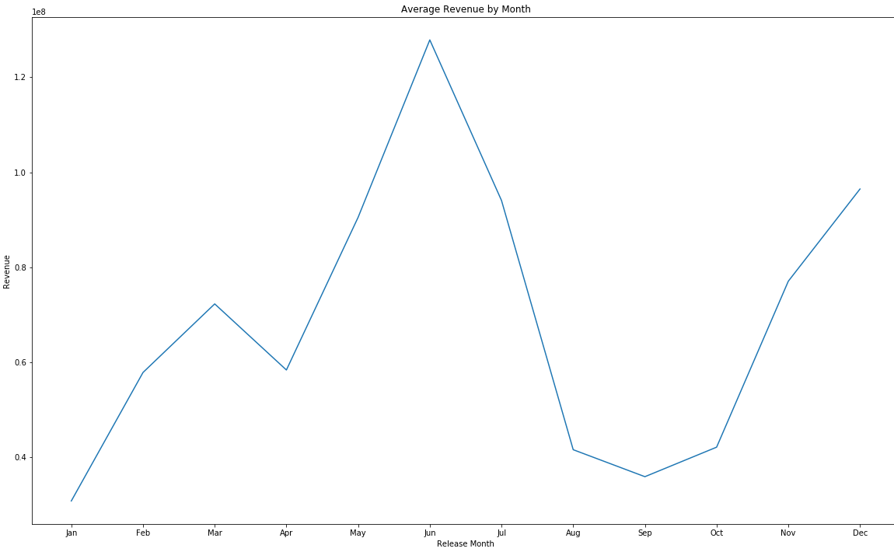
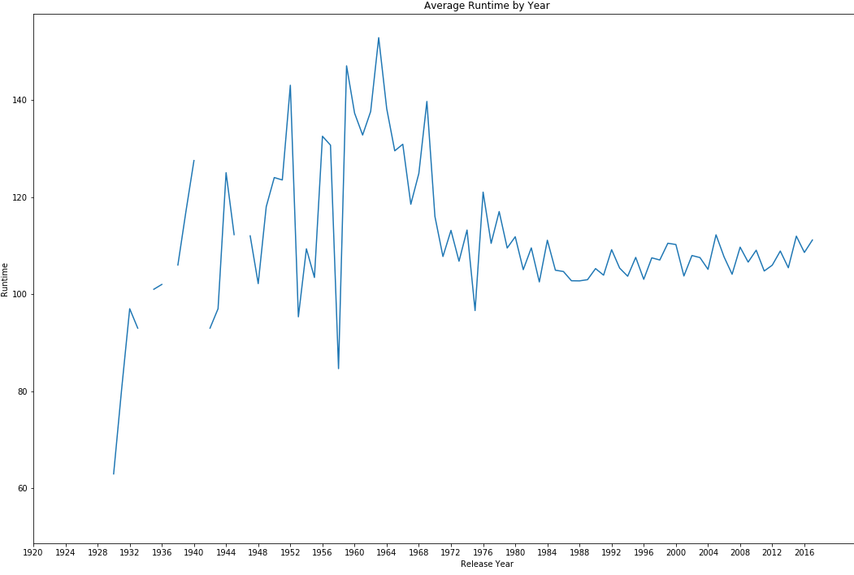
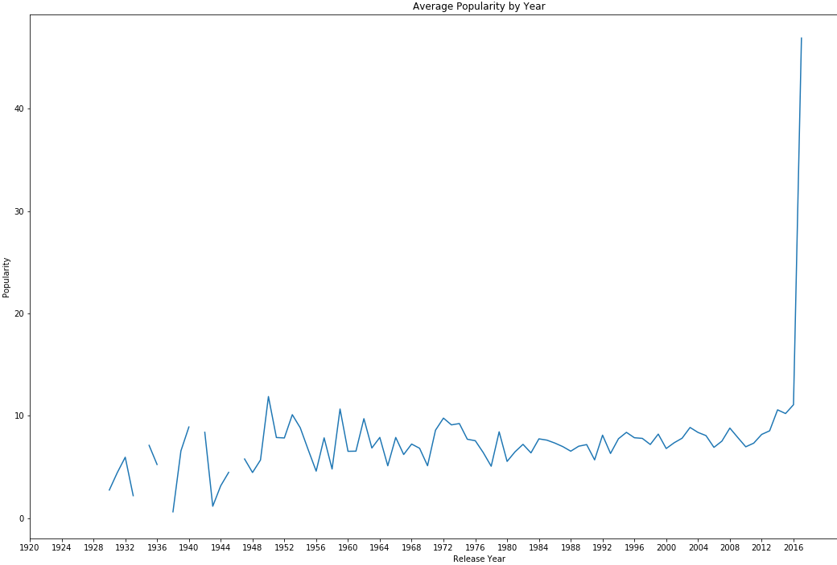

Slide 6
Random Forest Regressor
Inputs used:
budget, popularity, runtime, genres, homepage (yes/no), tagline (yes/no), belongs to collection (yes/no), original language is English (yes/no), cast count, crew count

Slide 7
Random Forest Regressor
rf = RandomForestRegressor(n_estimators=200, n_jobs=1)
rf = rf.fit(X_train, y_train)
rf.score(X_test, y_test)
0.6632412715434837

Slide 8
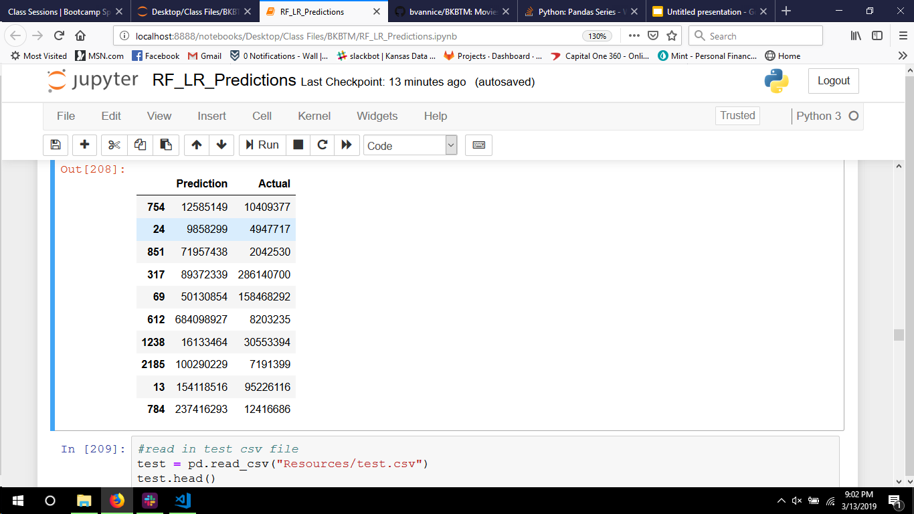
Random Forest Regressor

Slide 9
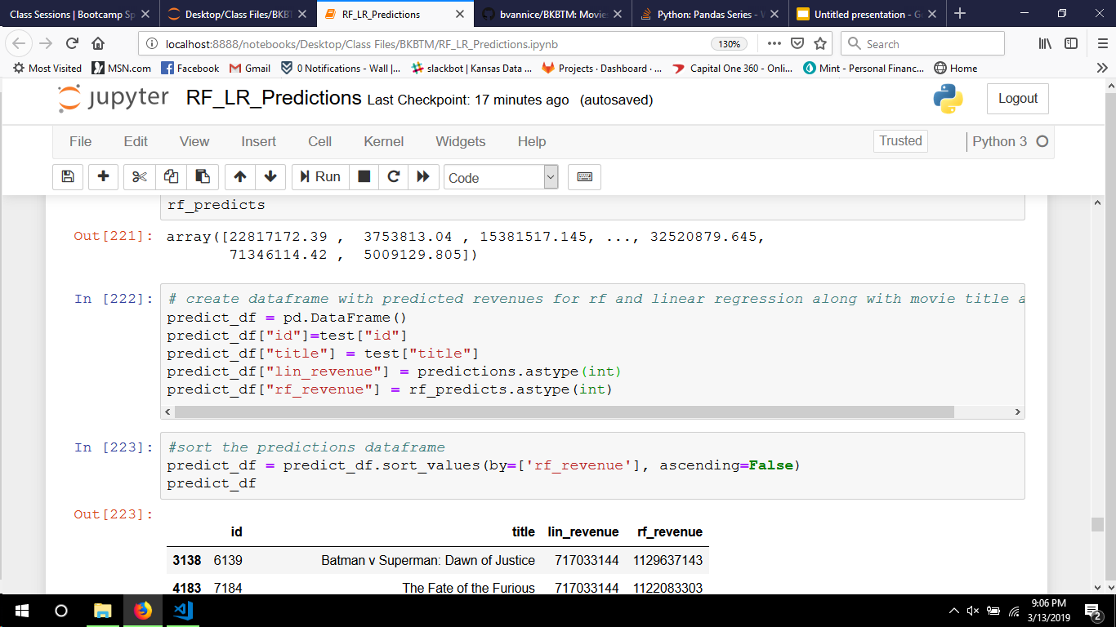
Random Forest Regressor

Slide 10
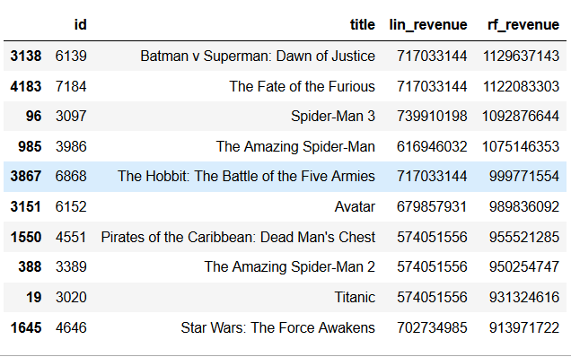
Random Forest Regressor

Slide 11
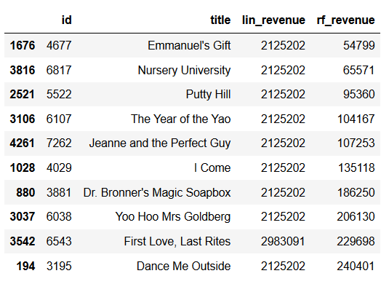
Random Forest Regressor

Slide 12
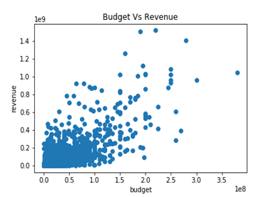
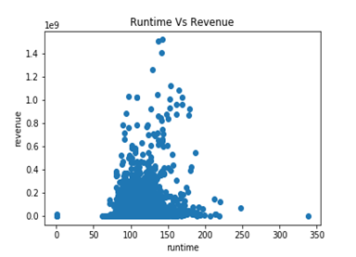
Analysis of Data

Slide 13
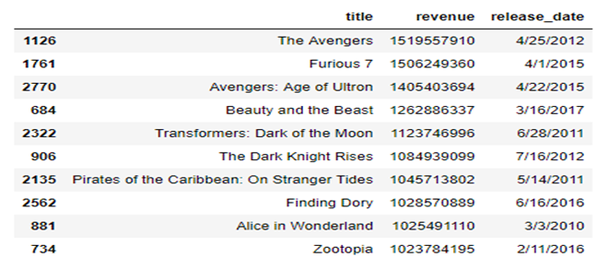
Top Ten Movies by Revenue

Slide 14
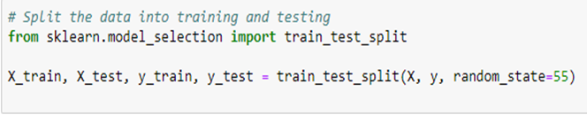
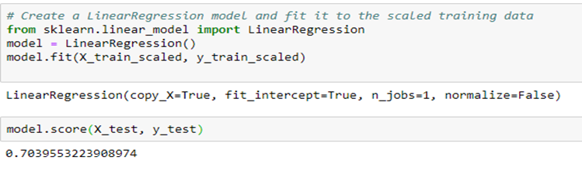
Creation and Score of Linear Regression Model

Slide 15
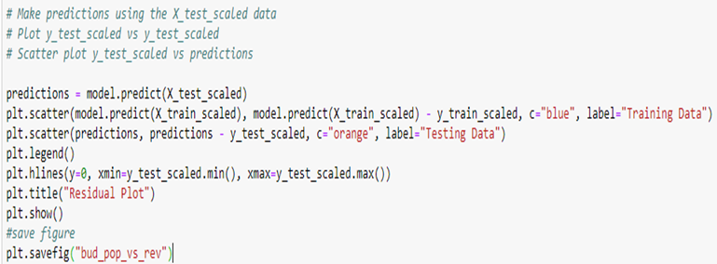
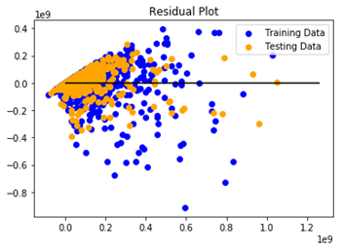
Graph of Residual Data generated

Slide 16
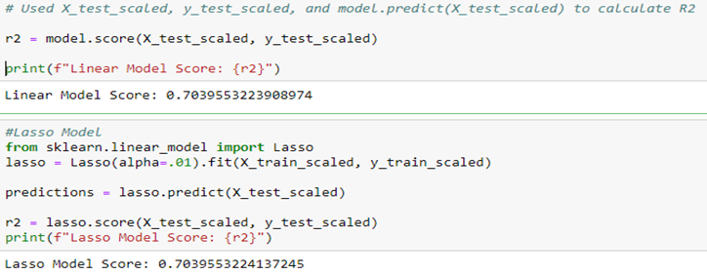
Other models created and Scored

Slide 17
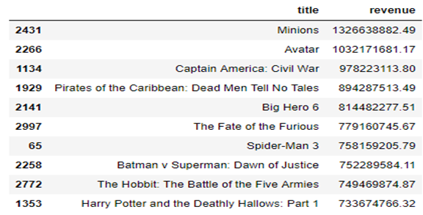
Predictions

